Slide 1
Rotary Friendship Exchange
Notes:
Change footnote to appropriate program name. Click View>Master>Slide Master>(edit footnote). This will change it on all slides. Insert program symbol. Do not copy and paste photos and graphics. Insert from a saved file. Minimum font size 24 in body of slide, type directly over titles and subtitles to keep standard.

Slide 2
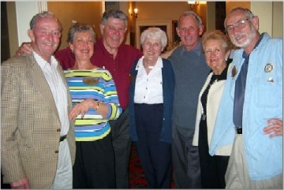
What is Friendship Exchange?
Friendship Exchange is an international exchange program for Rotarians and their families that provides participants with the opportunity to experience other cultures by staying in the homes of Rotarians in other countries.
Notes:
Insert short program description and photo. How and who/what does the program help and why?

Slide 3
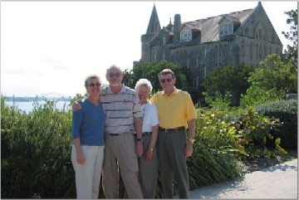
Friendship Exchange Goals
Advance international understanding and peace through personal contact across borders.
Meet Rotarians from other countries and learn about their culture firsthand
Arrange international service projects directly with Rotarians in another country
Develop long-lasting club relationships
Notes:
Insert 2-3 reasons in bullet format to participate in the program, how it contributes to Rotary’s mission and insert photo.

Slide 4
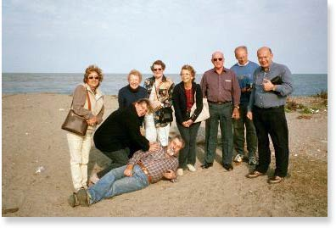
Building a Friendship Exchange
Interested Rotarians must apply through their club president, who will inform them if their district participates in the program.
District chairs work with their counterparts around the world to organize all aspects of exchanges.
RI produces a list of district Friendship Exchange chairs on a quarterly basis to help with communication.
Notes:
Insert key steps in organizing the program and getting started in bullet format and photo. Edit title to reflect slide content.

Slide 5
Types of Exchanges
Visitor Program
Individual Rotarians, who may be accompanied by family members, spend a few days in the home of a Rotarian in another country.
Team Program
Rotarian couples, typically four to six, visit several communities in a host district for up to one month.
Uni-vocational
Host and guest Rotarians of the same occupation observe how their job is done in other countries.
Notes:
Insert information in bullet format on how a Rotary club provides ongoing support for the program. How do Rotarians serve as resources for the program?

Slide 6
Friendship Exchange Guidelines
It is expected that all exchanges be reciprocal.
Friendship Exchanges may take place at any time during the year that is agreeable to the clubs and districts involved.
Reciprocal visits may take place during the same year or in the following year.
The length of stay for participants in the visitor program is several (three or four) days, while those in the team program visit several communities in the host district for period of up to four weeks.
In all cases, guests are expected to pay their travel and personal expenses. Hosts are to provide housing, meals, and sightseeing opportunities. Variations from this standard are only at the host family’s discretion and should not be requested or expected.
Notes:
Insert important program guidelines in bullet format.

Slide 7
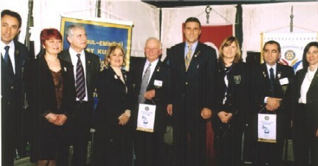
Itineraries
Exchanges incorporate a wide array of social events, local activities, and leisure time. Each itinerary is different but will most likely include attending a Rotary meeting or gathering in the host district.
Notes:
Insert brief information on key program projects and/or activities and photo. Edit title to reflect slide content.

Slide 8
District Chair Responsibilities
Promote the program and encourage participation within the district.
Help plan itineraries for participants.
Maintain records on exchange participants and potential hosts for future exchanges.
Communicate with other district chairs and clubs when developing Friendship Exchanges.
Submit and update district profiles on the RFE Matching Board.
Notes:
Insert information on the district level program structure. Who are the key district leaders and how do they serve the interests of the program?

Slide 9
Online Resources
For general program information, please go to www.rotary.org > Service and Fellowship > Rotary Friendship Exchange.
On the Web site, you may access the following resources:
Rotary Friendship Exchange Handbook
Rotary Friendship Exchange Matching Board
Building Cultural Awareness
Notes:
Insert program name and appropriate contact information.

Slide 10
Contact RI Staff
Rotary International
Programs & Presidential Initiatives Section
Phone: 1-847-866-3460
Fax: 1-847-556-2182
E-mail: friendshipexchange@rotary.org
Rotary International
1560 Sherman Avenue
Evanston, IL 60201-3698
USA

